Slide 1

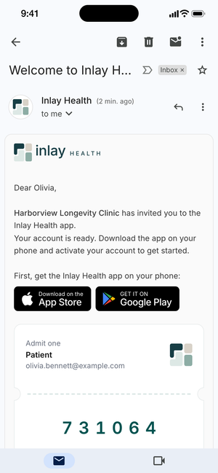
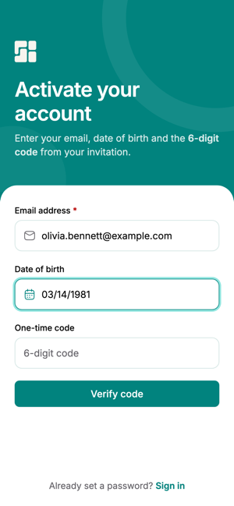
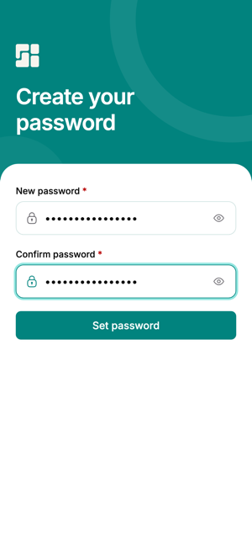
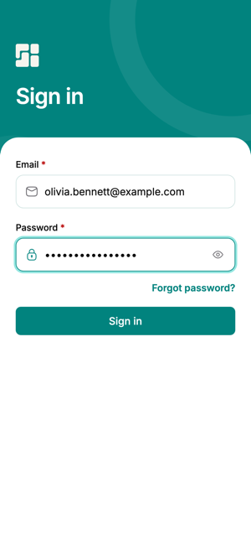
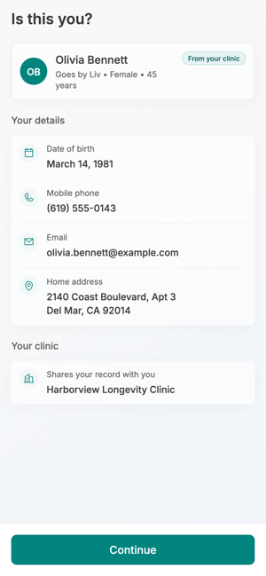
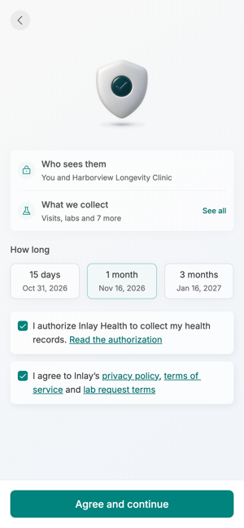
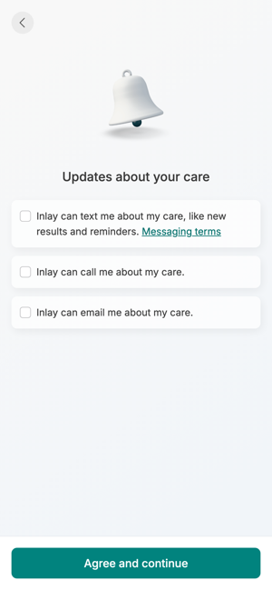
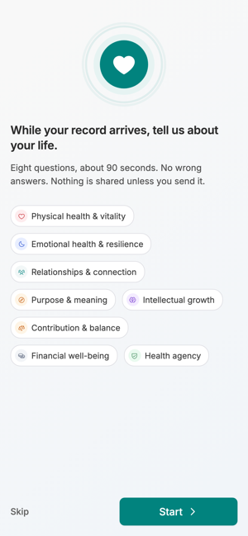
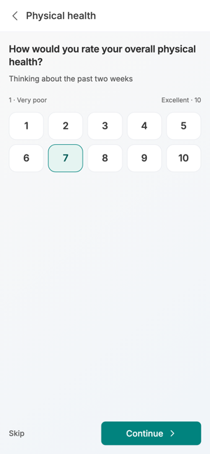
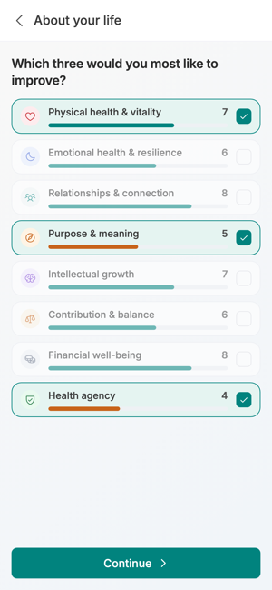
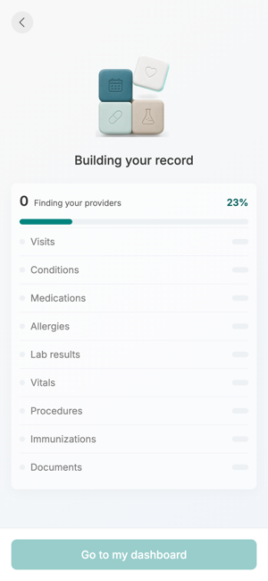
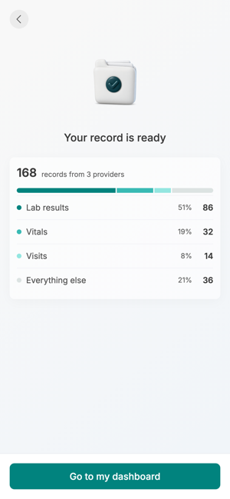
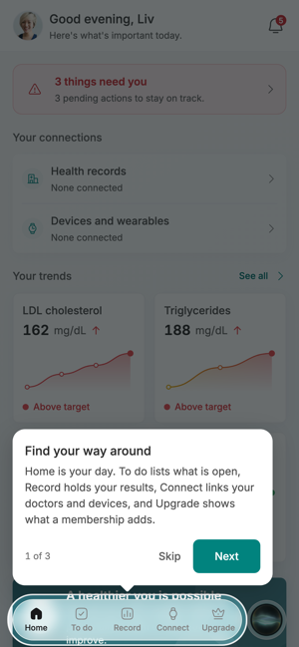
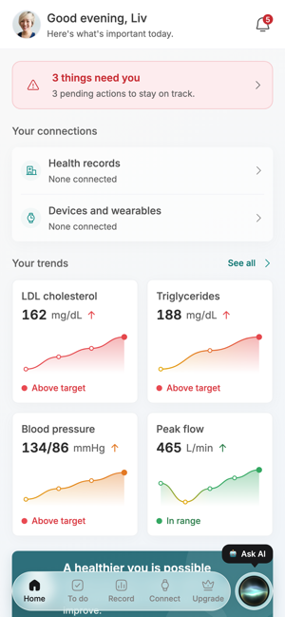
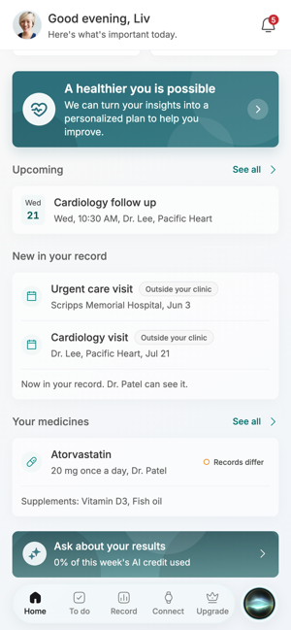
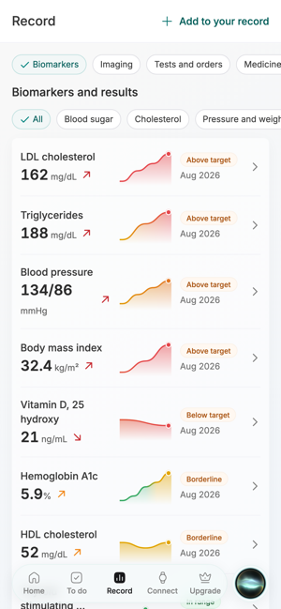
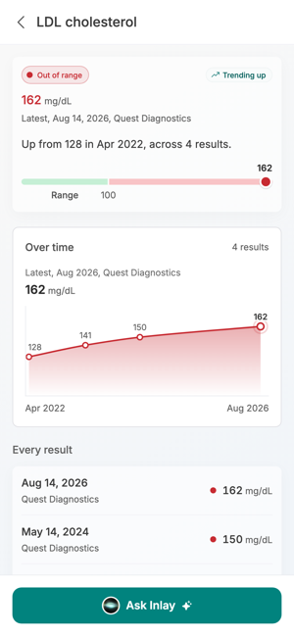
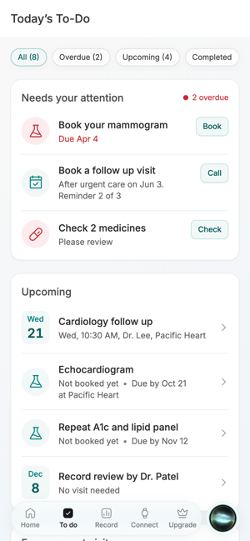
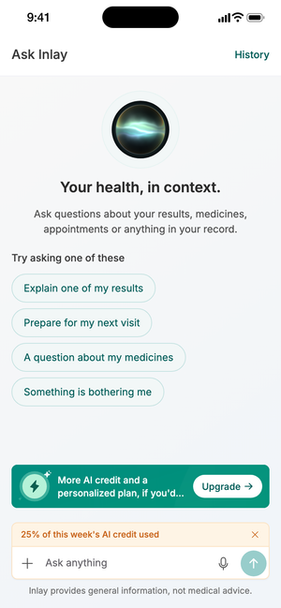
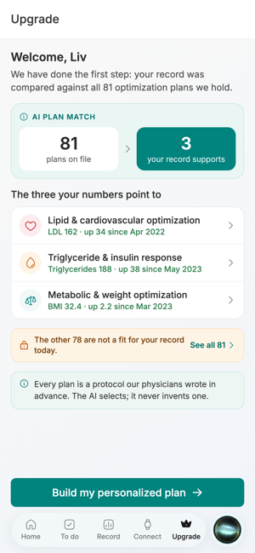
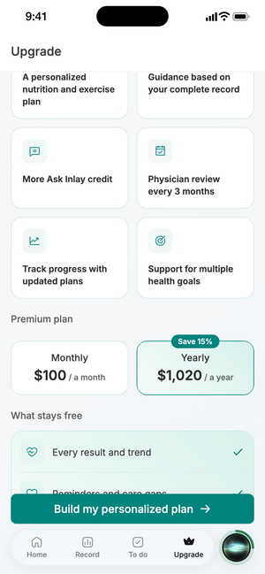
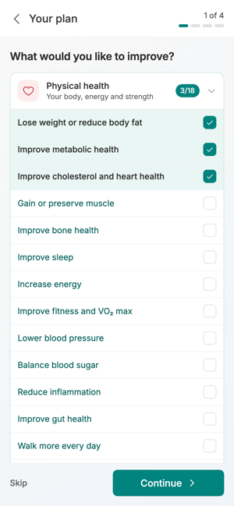
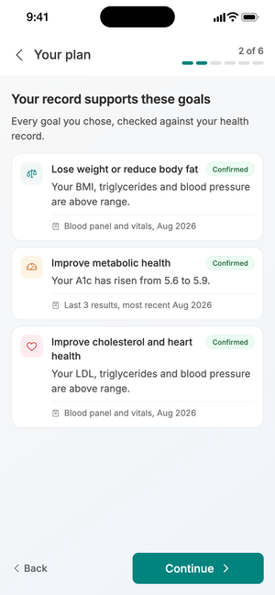
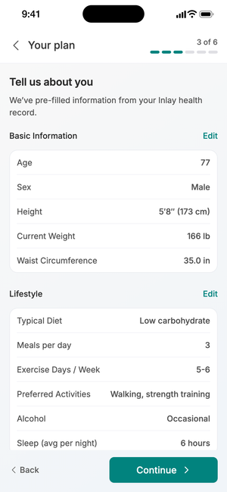
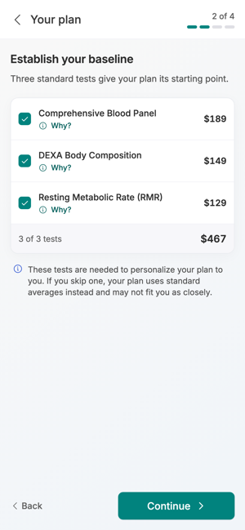
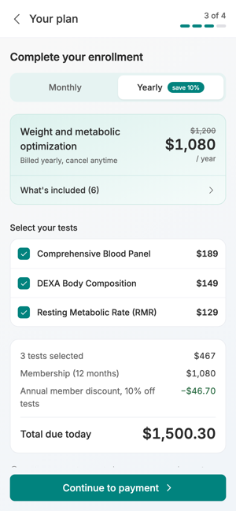
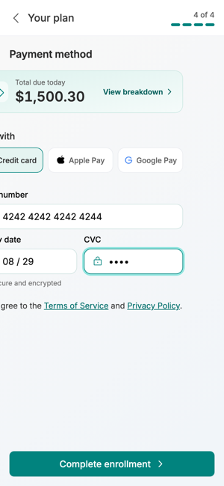
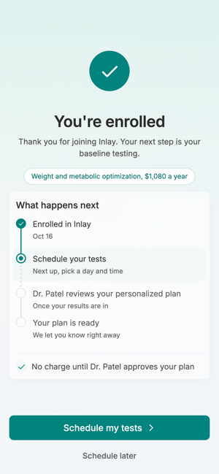
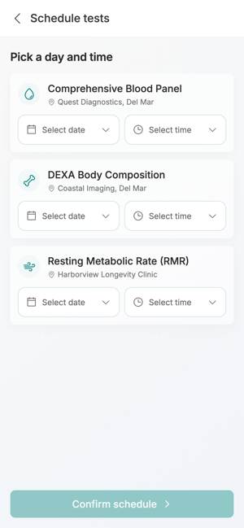
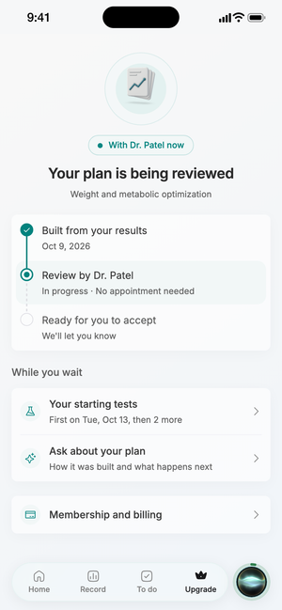
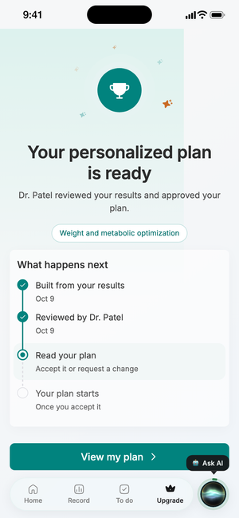
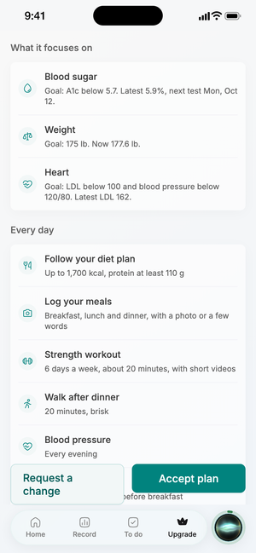
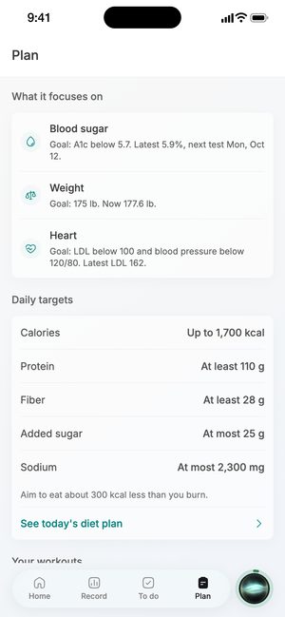
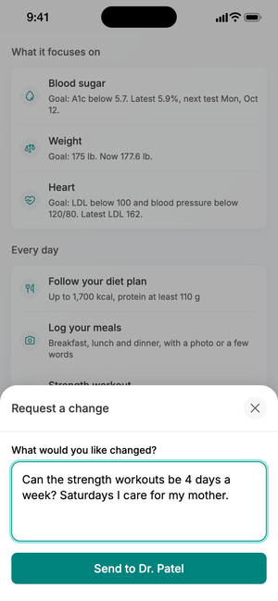
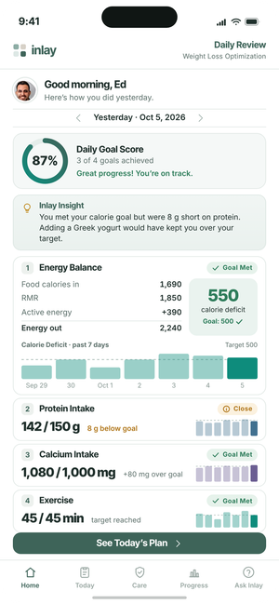
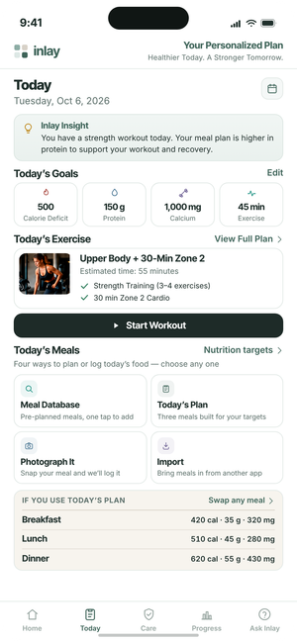
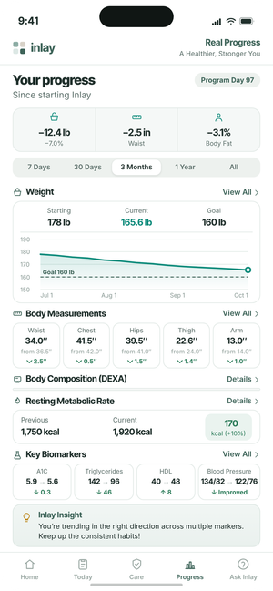
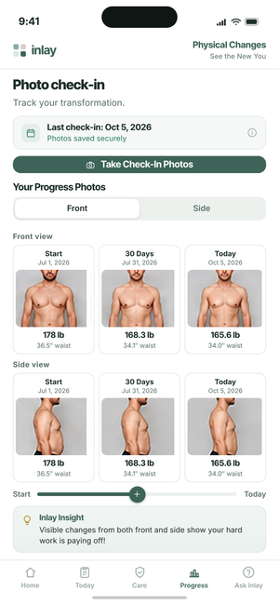
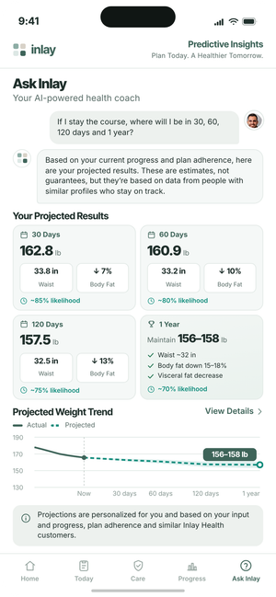
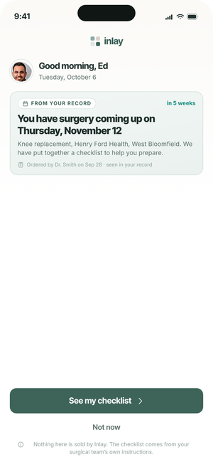
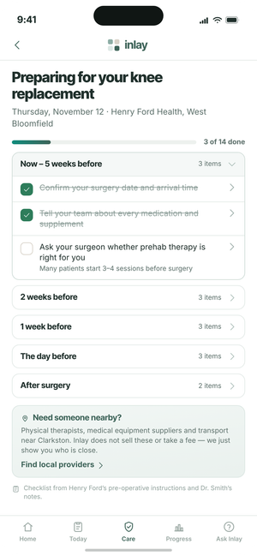
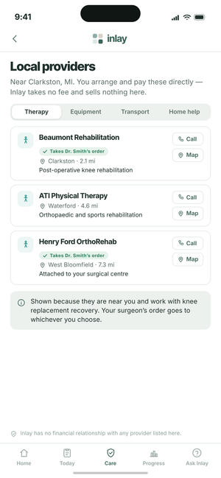
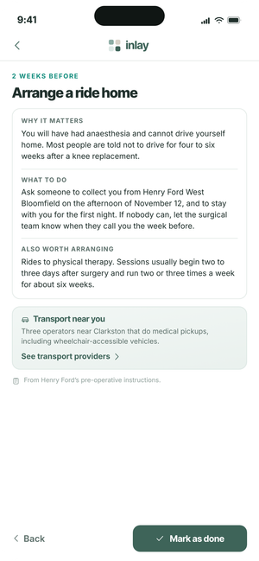
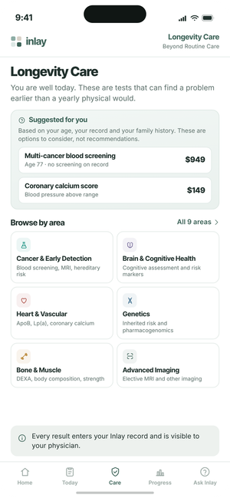
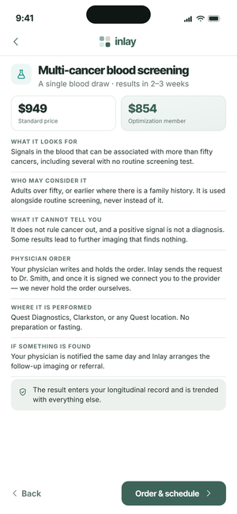
OPTIMIZATION PROGRAM
The Patient Journey
Forty-five screens, from the invitation email in the inbox to the morning Inlay sees what is coming next.
01 Activate & Sign In
02 Identity & Consent
03 Onboarding
04 Dashboard
05 Free Plan & Upgrade
06 Daily Use
07 Inlay Care
45 screens · 7 stages
Internal discussion draft · October 2026
Free flow 1–19 updated to the 16 Oct app build; paid flow 20–45 unchanged

Slide 2

The journey end to end
Seven stages. The patient is never asked to do work the record can do for them.
01
02
03
04
05
06
07
ACTIVATE & SIGN IN
IDENTITY & CONSENT
ONBOARDING
DASHBOARD
FREE PLAN & UPGRADE
DAILY USE
INLAY CARE
From the clinic's invitation email to a signed in patient, with one code.
Confirm the clinic's details, then one consent before anything is read.
Eight life questions, three picked, then the record builds in front of them.
The free record: what needs them, trends, to do and Ask Inlay.
Goals to payment to Dr. Patel's review, then accept or ask for a change.
Yesterday's score, today's plan, progress, photographs and the projection.
Free surgery support, alongside Longevity Care, which stays paid.
›
›
›
›
›
›
1
2
3
4
5
6
7
8
9
10
11
12
13
14
15
16
17
20
21
22
23
24
35
36
37
38
39
40
41
42
43
44
18
19
25
26
27
28
29
45
30
31
32
33
34
INLAY HEALTH · OPTIMIZATION PATIENT JOURNEY
OVERVIEW
2

Slide 3
STAGE 01
Activate & Sign In
Four screens from the invitation email to a signed in patient. The clinic sends one code; the patient never invents a username or waits for a call.
1
2
3
4
Screens 1–4

Slide 4
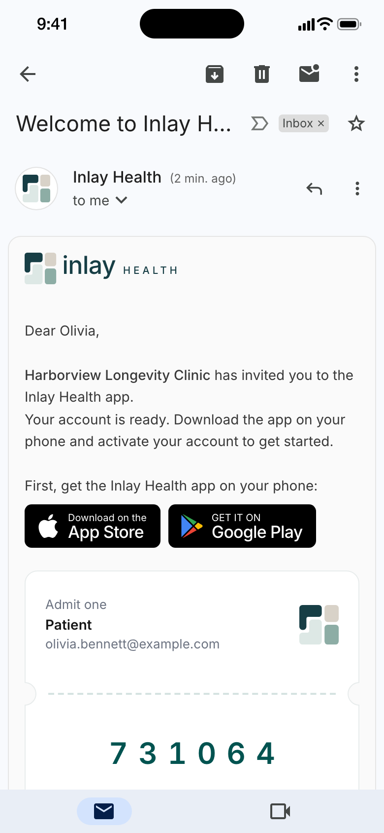
01
STAGE 01 · ACTIVATE & SIGN IN
Invitation Email
One email, one code
The clinic invites the patient from the portal. The email carries the store links and a six digit activation code, and nothing else: no link to click, no ID, no password.
Sent in the clinic’s name: Harborview Longevity Clinic invites Olivia, signed by its clinic manager
The admit one card names the patient, the email and the code 731064, valid once, for 48 hours
A code that runs out is replaced by the clinic, so help stays with the practice the patient knows
INLAY HEALTH · OPTIMIZATION PATIENT JOURNEY
SCREEN 1 OF 45
4

Slide 5

02
STAGE 01 · ACTIVATE & SIGN IN
Activate Your Account
Email, birth date, one-time code
The code is checked against the email and date of birth the clinic already holds, so a code on its own cannot open anyone’s record.
Three fields and one button; the code is verified as soon as the sixth digit is typed
Date of birth is the second check, taken from the practice record rather than invented at sign up
“Already set a password? Sign in” keeps returning patients off this screen
INLAY HEALTH · OPTIMIZATION PATIENT JOURNEY
SCREEN 2 OF 45
5

Slide 6

03
STAGE 01 · ACTIVATE & SIGN IN
Create Your Password
The only thing the patient chooses
Once the code is accepted the patient sets a password, with the same rules as the web portals. There is no username to invent and no second factor to set up.
New password and confirmation, each with show and hide
Going back cancels the code, so a half finished activation cannot be reused
Face ID is offered later, from settings, once the patient is signed in
INLAY HEALTH · OPTIMIZATION PATIENT JOURNEY
SCREEN 3 OF 45
6

Slide 7

04
STAGE 01 · ACTIVATE & SIGN IN
Sign In
Straight back in
Straight after the password is created the email is already filled in, so the new password is all there is to type.
Returning patients land here too: email and password, or Face ID once it is turned on
Forgot password sits under the field rather than behind a menu
A session left idle for 15 minutes comes back to this screen
INLAY HEALTH · OPTIMIZATION PATIENT JOURNEY
SCREEN 4 OF 45
7

Slide 8
STAGE 02
Identity & Consent
The patient confirms who they are from the clinic's own record, then gives one consent before anything medical is read.
Screens 5–7
5
6
7

Slide 9
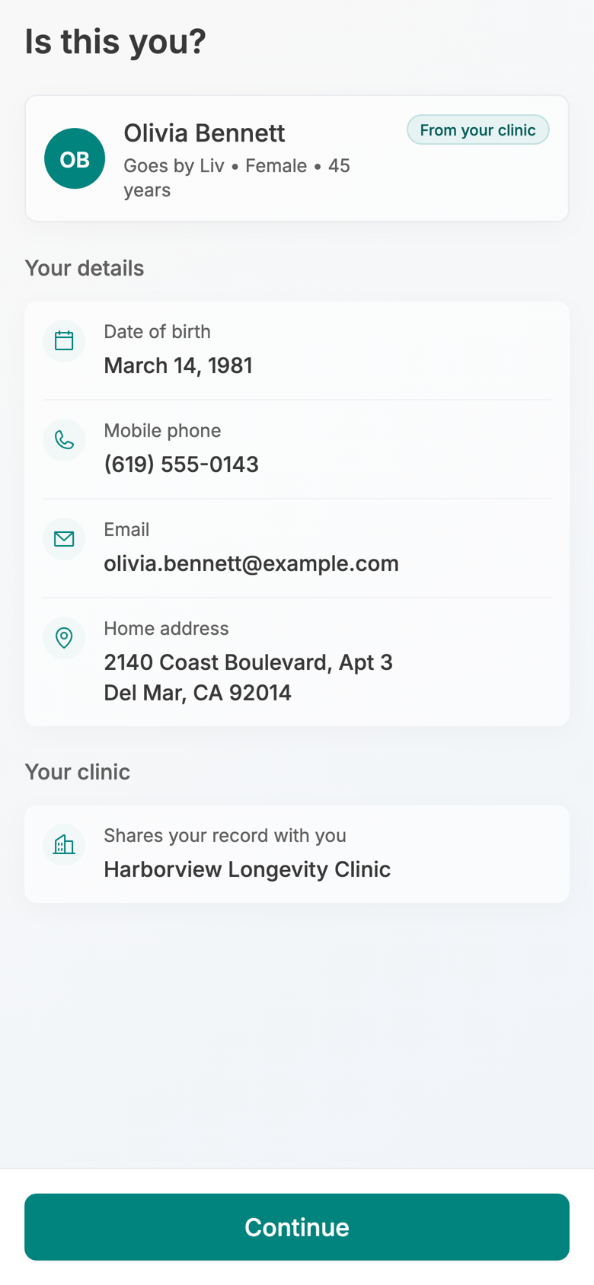
05
STAGE 02 · IDENTITY & CONSENT
Is This You?
Confirm, don’t type
The details come from the clinic’s record and are shown view only. They are what the national networks match the patient on, so they have to be the practice’s own.
Name, preferred name, sex and age first: who the patient is, the way they would recognise themselves
Date of birth, mobile, email and home address, then the clinic that shares the record
A From your clinic tag says where every field came from; one action, Continue
INLAY HEALTH · OPTIMIZATION PATIENT JOURNEY
SCREEN 5 OF 45
9

Slide 10
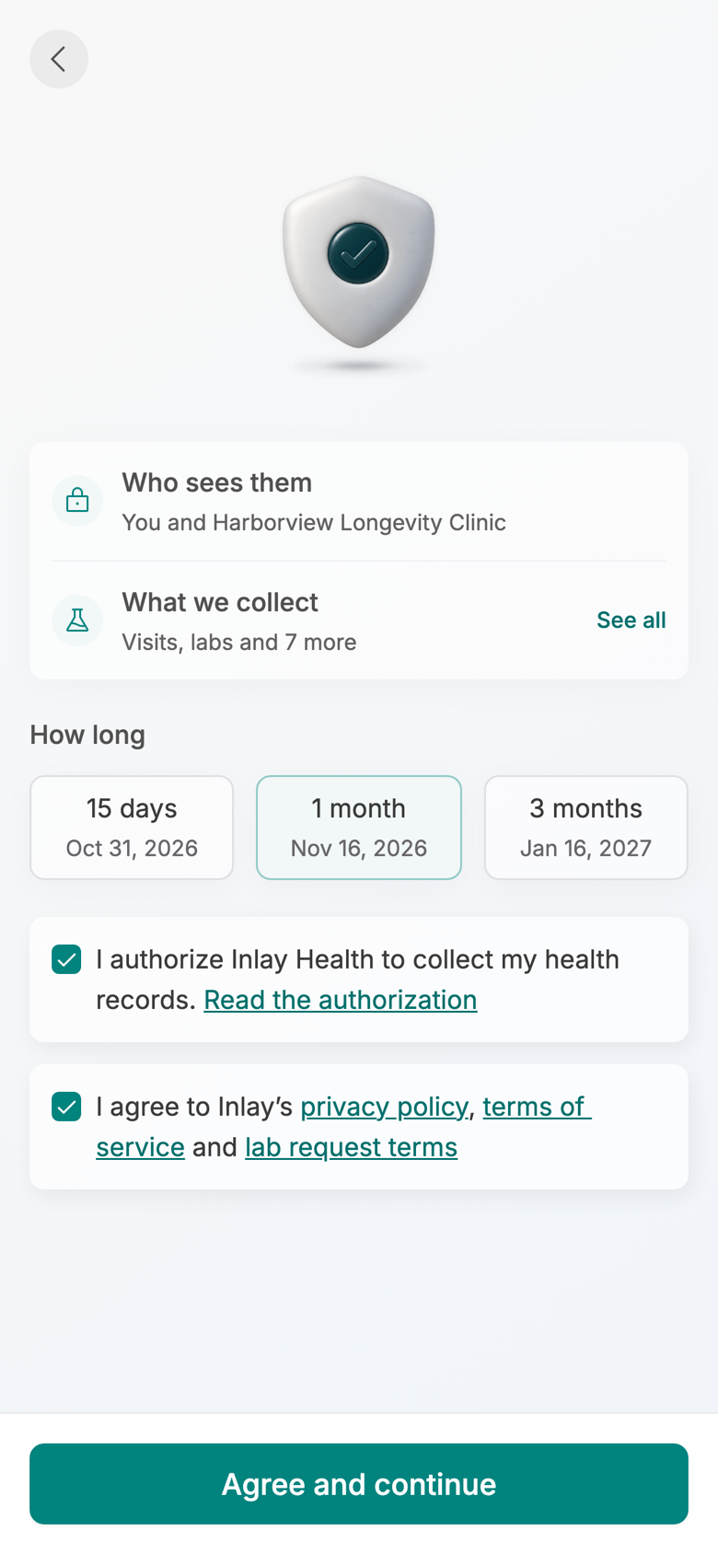
06
STAGE 02 · IDENTITY & CONSENT
Connect Your Health Records
Consent comes before any data
Nothing medical is read until the patient agrees. The screen says who sees the records, what is collected and for how long, in three lines rather than a legal page.
Who sees them: the patient and Harborview Longevity Clinic. What we collect: visits, labs and 7 more
The patient picks how long: 15 days, 1 month or 3 months, each with its end date
Two boxes, the authorization and the terms, with the full text of each one tap away
INLAY HEALTH · OPTIMIZATION PATIENT JOURNEY
SCREEN 6 OF 45
10

Slide 11
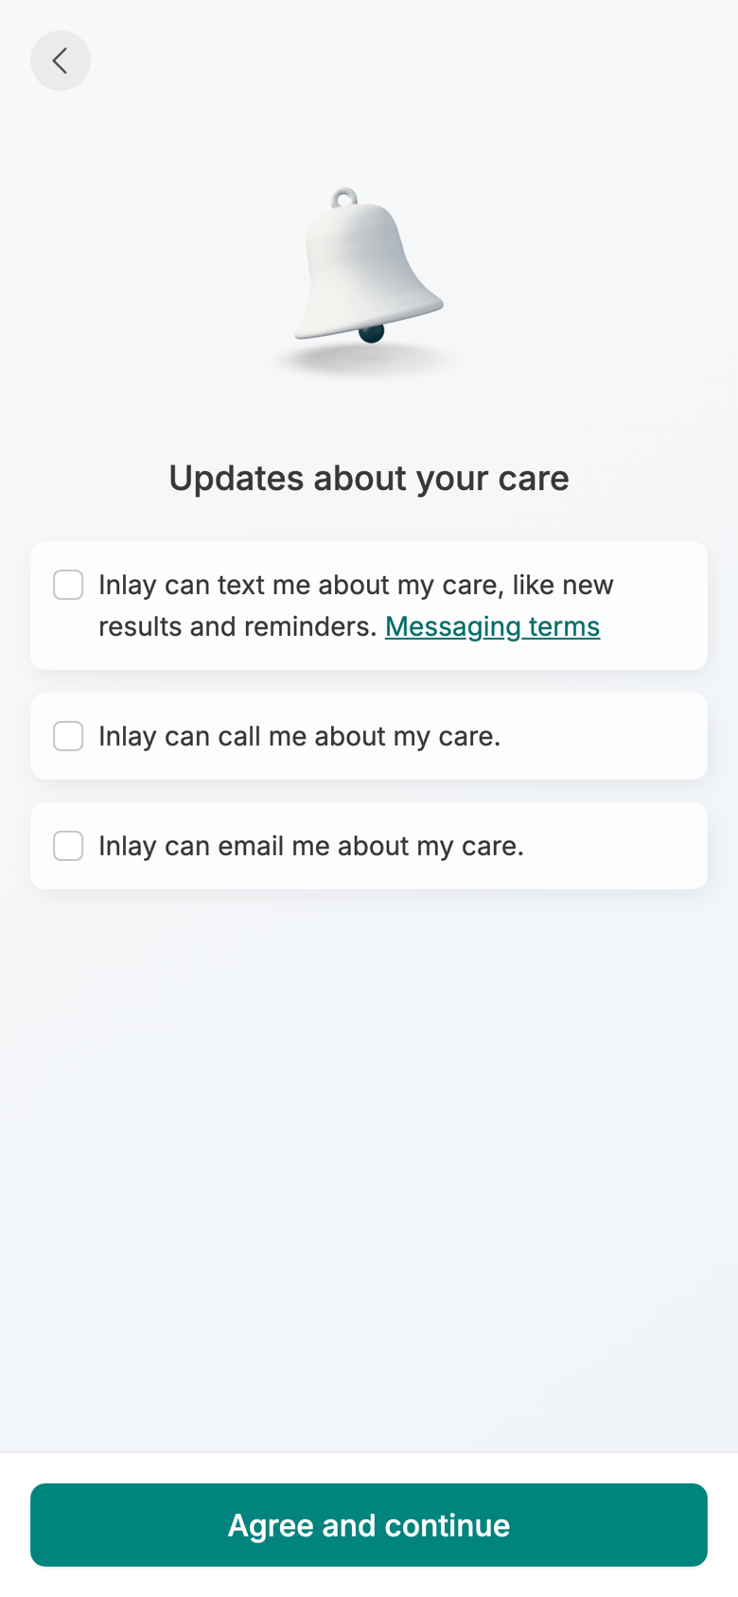
07
STAGE 02 · IDENTITY & CONSENT
Updates About Your Care
How Inlay may reach them
The second consent page covers contact about care: texts, calls and email. Agreeing here signs the consent and starts the record pull.
Three separate permissions, so a patient can take texts and decline calls
Messaging terms are linked from the text option, where carriers expect them
Agree and continue goes straight into the assistant’s first conversation
INLAY HEALTH · OPTIMIZATION PATIENT JOURNEY
SCREEN 7 OF 45
11

Slide 12
STAGE 03
Onboarding
8
9
10
11
Eight life questions while the record arrives, three areas picked, then the record builds while the patient watches.
Screens 8–12
12

Slide 13
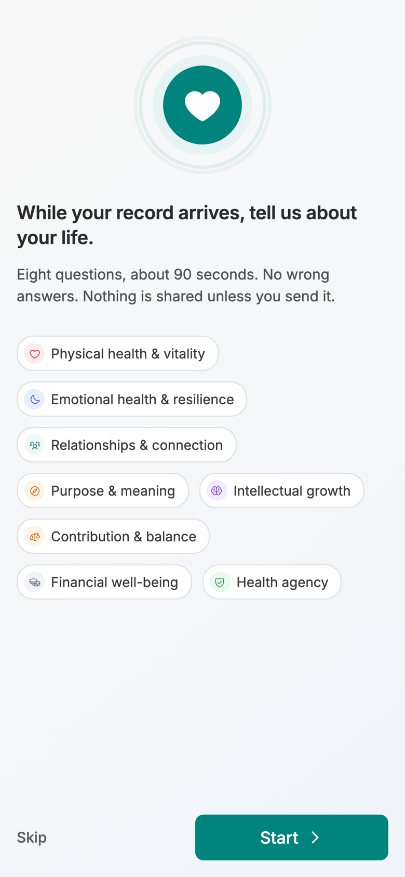
08
STAGE 03 · ONBOARDING
About Your Life
Eight questions while the record arrives
Consent starts the record pull, and the wait is used for the patient’s life rather than their results: eight flourishing questions, about 90 seconds, no wrong answers.
“Eight questions, about 90 seconds” sets expectations before the first one
The eight areas are listed up front: physical, emotional, relationships, purpose, growth, balance, finances, health agency
Start, or Skip straight to the record; nothing is shared unless the patient sends it
INLAY HEALTH · OPTIMIZATION PATIENT JOURNEY
SCREEN 8 OF 45
13

Slide 14

09
STAGE 03 · ONBOARDING
Life Question
One area, one question, one scale
Each area gets its own screen: how would you rate your overall physical health, thinking about the past two weeks.
A 1 to 10 scale, from Very poor to Excellent, answered in one tap
Skip is always there, so no question stands between the patient and their record
Eight screens in all, about 90 seconds, while the record keeps building
INLAY HEALTH · OPTIMIZATION PATIENT JOURNEY
SCREEN 9 OF 45
14

Slide 15

10
STAGE 03 · ONBOARDING
Pick Three
What they most want to improve
The eight scores come back as one list, and the patient picks the three they would most like to improve.
Each area shows the patient’s own score, so the lowest ones stand out without a chart
Three picks, then Continue goes back to the record being built
The picks feed the plan match on the Upgrade tab and the Human Flourishing Index
INLAY HEALTH · OPTIMIZATION PATIENT JOURNEY
SCREEN 10 OF 45
15

Slide 16

11
STAGE 03 · ONBOARDING
Building Your Record
The record builds in front of them
Consent starts the pull from every provider the networks find. The screen tells it the way a patient thinks about it: a running count, one bar, then each kind of record landing.
Finding your providers first, then visits, conditions, medications, labs, vitals and the rest
The real pull can take minutes, so the patient may leave and is told when it is ready
Go to my dashboard stays off until there is something to show
INLAY HEALTH · OPTIMIZATION PATIENT JOURNEY
SCREEN 11 OF 45
16

Slide 17

12
STAGE 03 · ONBOARDING
Your Record Is Ready
168 records from 3 providers
The finished record is summarised before the dashboard opens, so the first thing the patient learns is how much of their history Inlay already holds.
Lab results 86, vitals 32, visits 14 and everything else 36, each with its share of the total
Three providers found, including care outside the patient’s own clinic
One action: Go to my dashboard
INLAY HEALTH · OPTIMIZATION PATIENT JOURNEY
SCREEN 12 OF 45
17

Slide 18
STAGE 04
Dashboard
13
14
15
16
The free record, every day: what needs attention, how results are moving, what is coming up, and an assistant that knows the record.
Screens 13–19
17
18
19

Slide 19

13
STAGE 04 · DASHBOARD
First Look: App Tour
Five tabs, explained once
The first time Home opens, a three step tour names the tabs. It runs once, over the live dashboard, and can be skipped.
Home is your day, To do lists what is open, Record holds results, Connect links doctors and devices, Upgrade shows what a membership adds
The tour points at the floating tab bar and the assistant circle beside it
Skip ends it at once; Next walks through the remaining two steps
INLAY HEALTH · OPTIMIZATION PATIENT JOURNEY
SCREEN 13 OF 45
19

Slide 20

14
STAGE 04 · DASHBOARD
Home
What needs them, first
The free home leads with what the patient has to act on, then how their results are moving. Every trend is drawn from their own record.
3 things need you: a muted red card for pending actions, one tap from the To do list
Four trend tiles: BMI 32.4, LDL 162 and triglycerides 188 above target, ferritin 46 in range
Your connections sits under the alert: health records and devices, with None connected until the patient links one
INLAY HEALTH · OPTIMIZATION PATIENT JOURNEY
SCREEN 14 OF 45
20

Slide 21

15
STAGE 04 · DASHBOARD
Home: Further Down
Upcoming, new, and medicines
Below the trends, Home shows what is booked, what has just arrived in the record, and the medicines on file.
Cardiology follow up on Oct 21 with Dr. Lee at Pacific Heart
New in your record: urgent care and cardiology visits outside the clinic, now visible to Dr. Patel
Records differ is flagged on atorvastatin; Ask about your results shows 25% of the week’s AI credit used
INLAY HEALTH · OPTIMIZATION PATIENT JOURNEY
SCREEN 15 OF 45
21

Slide 22

16
STAGE 04 · DASHBOARD
Record
Every result, with its trend
The Record tab holds the whole record: biomarkers, tests and orders, medicines, conditions, visits and more, with results grouped by body system.
Category pills on top, body system chips under them: blood sugar, cholesterol, heart and weight
Each row has the value, its status, a small trend and the date; out of range results come first
Add to your record takes a result from outside the network
INLAY HEALTH · OPTIMIZATION PATIENT JOURNEY
SCREEN 16 OF 45
22

Slide 23

17
STAGE 04 · DASHBOARD
Result Detail
LDL 162, and how it got there
Opening a result shows the latest value against its range, every past reading on one chart, and where each one came from.
Out of range and trending up: 162 mg/dL against a target under 100, up from 128 in April 2022
Four results on the chart, each listed with its date and source, Quest Diagnostics
What a plan adds is listed further down, and the page says plainly that it stays free
INLAY HEALTH · OPTIMIZATION PATIENT JOURNEY
SCREEN 17 OF 45
23

Slide 24

18
STAGE 04 · DASHBOARD
To Do
What is open, in order
Care gaps, bookings and checks in one list, split into overdue, upcoming and completed.
2 overdue: book a mammogram, due Apr 4, and a follow up visit after urgent care on Jun 3
Check 2 medicines; an echocardiogram and a repeat A1c and lipid panel wait to be booked
Dr. Patel’s record review on Dec 8 is listed with No visit needed
INLAY HEALTH · OPTIMIZATION PATIENT JOURNEY
SCREEN 18 OF 45
24

Slide 25

19
STAGE 04 · DASHBOARD
Ask Inlay
An assistant that knows the record
The assistant opens on four plain starting points. Credit is shown as a share of the week used, never as a count of questions.
Explain one of my results, prepare for my next visit, a question about my medicines, something is bothering me
25% of this week’s AI credit used, on a strip above the composer
General information, not medical advice, stated under every conversation
INLAY HEALTH · OPTIMIZATION PATIENT JOURNEY
SCREEN 19 OF 45
25

Slide 26
STAGE 05
Free Plan & Upgrade
20
21
22
23
24
From the Upgrade tab to a physician approved plan: the AI plan match, then four steps (goals, baseline tests, enrollment, payment), scheduling and review, then accept or ask for a change.
25
26
27
28
29
Screens 20–34
30
31
32
33
34

Slide 27

20
STAGE 05 · FREE PLAN & UPGRADE
Upgrade
Welcome first, then the match
The Upgrade tab greets the patient by preferred name and says the first step is done: their record was compared against all 81 optimization plans.
AI plan match: 81 plans on file, 3 the record supports, each with the number behind it
Lipid and cardiovascular (LDL 162, up 34), triglyceride and insulin response, metabolic and weight
See all 81, then Build my personalized plan
INLAY HEALTH · OPTIMIZATION PATIENT JOURNEY
SCREEN 20 OF 45
27

Slide 28

22
STAGE 05 · FREE PLAN & UPGRADE
Select Your Goals
Goals by area, step 1 of 4
Goals are grouped by life area, the same areas as the onboarding questions, and several can be picked.
Physical health opens first: lose weight, metabolic health, cholesterol and heart, muscle, bone, sleep
Emotional well-being, relationships, purpose and intellectual growth each hold their own goals
Other takes the patient’s own words; Skip returns to the Upgrade tab
INLAY HEALTH · OPTIMIZATION PATIENT JOURNEY
SCREEN 22 OF 45
29

Slide 29

25
STAGE 05 · FREE PLAN & UPGRADE
Establish Your Baseline
What the record is missing
Step 2 of 4. Three standard tests give the plan its starting point, each priced, each with a Why?
$189 blood panel, $149 DEXA, $129 RMR: 3 of 3 tests, $467
All three ticked to start; any of them can be cleared
The screen says why the tests are needed to personalize the plan
INLAY HEALTH · OPTIMIZATION PATIENT JOURNEY
SCREEN 25 OF 45
32

Slide 30

26
STAGE 05 · FREE PLAN & UPGRADE
Complete Your Enrollment
Monthly or yearly, tests included
Step 3 of 4. The plan named from the goals, monthly or yearly billing, and the tests chosen on the last step.
Yearly saves 10%: $1,200 becomes $1,080 a year, cancel anytime
Members get 10% off the baseline tests too
What’s included (6) opens the membership’s full list; Continue to payment
INLAY HEALTH · OPTIMIZATION PATIENT JOURNEY
SCREEN 26 OF 45
33

Slide 31

27
STAGE 05 · FREE PLAN & UPGRADE
Payment Method
Pay and agree on one screen
Step 4 of 4. The total follows the plan chosen on the last step, its breakdown a tap away.
Total due today $1,500.30, with View breakdown
Credit card, Apple Pay or Google Pay; card fields marked secure and encrypted
Complete enrollment stays off until the terms are ticked
INLAY HEALTH · OPTIMIZATION PATIENT JOURNEY
SCREEN 27 OF 45
34

Slide 32

28
STAGE 05 · FREE PLAN & UPGRADE
You’re Enrolled
What happens next, in order
The membership has started, and the screen lists each next step with the physician named.
Weight and metabolic optimization, $1,080 a year, enrolled Oct 16
Schedule your tests next; Dr. Patel reviews the plan once results are in
Schedule my tests, or Schedule later, which keeps the tests in To do
INLAY HEALTH · OPTIMIZATION PATIENT JOURNEY
SCREEN 28 OF 45
35

Slide 33

29
STAGE 05 · FREE PLAN & UPGRADE
Schedule Tests
A day and a time for each test
Each paid test with its place, a date and a time. Confirm schedule books them all at once.
Blood panel at Quest Diagnostics, DEXA at Coastal Imaging, RMR at Harborview Longevity Clinic
Select date opens open weekdays, then the times for that day
Confirm schedule books all three
INLAY HEALTH · OPTIMIZATION PATIENT JOURNEY
SCREEN 29 OF 45
36

Slide 34

29a
STAGE 05 · FREE PLAN & UPGRADE
Your Tests Are Scheduled
Booked, then one offer
Confirm schedule lands here: every test with its day, time and place, and a reminder before each one.
Blood panel Tue Oct 20, DEXA Wed Oct 21, RMR Thu Oct 22, each with its place
Personalize my care opens the health questions while the patient waits for results
I’ll do this later goes to the plan; the questions stay open and nothing is lost
INLAY HEALTH · OPTIMIZATION PATIENT JOURNEY
SCREEN 29 OF 45
36

Slide 35

29b
STAGE 05 · FREE PLAN & UPGRADE
Tell Us About You
Pre-filled, then confirmed
The profile as the record has it, in three blocks. The patient confirms it and edits only what has changed.
Basic information: age 45, height, weight 213 lb, BMI 32.4, waist 41 in
Lifestyle edits in a sheet: diet, meals a day, exercise, alcohol and sleep
Medical is read from the record, never retyped; Confirm opens the questions
INLAY HEALTH · OPTIMIZATION PATIENT JOURNEY
SCREEN 29 OF 45
36

Slide 36

29c
STAGE 05 · FREE PLAN & UPGRADE
Your Why: Flourishing Questions
Eight areas, a few questions each
The assistant opens with the patient’s life, not their numbers, then asks the full flourishing set in the chat.
“No right answers, about ten minutes, skip any question” set expectations first
Every question uses one 1 to 10 scale, Worst to Best, and higher is always better
Answers are saved as they go and set the baseline the plan is measured from
INLAY HEALTH · OPTIMIZATION PATIENT JOURNEY
SCREEN 29 OF 45
36

Slide 37

30
STAGE 05 · FREE PLAN & UPGRADE
Your Plan Is Being Reviewed
With Dr. Patel now
The plan is built from the results and sent to the patient’s own physician. The review needs no appointment, and the screen says so.
Built from your results Oct 9, review by Dr. Patel in progress, then ready for you to accept
While you wait: your starting tests, Ask about your plan, membership and billing
The patient is told the moment the plan is approved
INLAY HEALTH · OPTIMIZATION PATIENT JOURNEY
SCREEN 30 OF 45
37

Slide 38

31
STAGE 05 · FREE PLAN & UPGRADE
Your Plan Is Ready
Approved, and attributed
Shown once, the first time the Plan tab opens after Dr. Patel sends version 1.
Dr. Patel reviewed your results and approved your plan
The next step is the patient’s: read the plan, then accept it or request a change
View my plan opens the plan itself
INLAY HEALTH · OPTIMIZATION PATIENT JOURNEY
SCREEN 31 OF 45
38

Slide 39

32
STAGE 05 · FREE PLAN & UPGRADE
Read Your Plan
Nothing starts until they accept
The full plan, with two actions side by side over the tab bar: Request a change and Accept plan.
Goals: A1c below 5.7, weight 175 lb, LDL below 100 and blood pressure below 120/80
Every day: a diet plan up to 1,700 kcal, logged meals, strength workouts and a walk after dinner
Request a change sits beside Accept plan, never behind a menu
INLAY HEALTH · OPTIMIZATION PATIENT JOURNEY
SCREEN 32 OF 45
39

Slide 40


33–34
If they accept
If they ask for a change
STAGE 05 · FREE PLAN & UPGRADE
Accept or Request a Change
Two ways forward
Accepting starts the plan at once. A change request sends the patient’s own words to Dr. Patel.
Accept: the Plan tab becomes the live plan, with daily targets and today’s diet plan
Request a change: one question, What would you like changed?, sent to Dr. Patel
Once accepted, the day starts with Yesterday, the next screen in this journey
INLAY HEALTH · OPTIMIZATION PATIENT JOURNEY
SCREENS 33–34 OF 45
40

Slide 41
STAGE 06
Daily Use
35
36
37
38
Five screens that run every day: yesterday's score, today's plan, measured progress, photographic evidence and the projection that renews the subscription.
Screens 35–39
39

Slide 42

35
STAGE 06 · DAILY USE
Yesterday: How Did I Do?
The first screen every morning
One score, one insight and four goals — the whole of yesterday in a single screen, with no scrolling required.
87% daily goal score, 3 of 4 goals achieved
Energy balance reconciles on screen: 2,240 kcal out, 1,690 in, a 550 deficit against a 500 goal
The insight names the one miss — 8 g of protein — and what would have closed it
INLAY HEALTH · OPTIMIZATION PATIENT JOURNEY
SCREEN 35 OF 45
42

Slide 43

36
STAGE 06 · DAILY USE
Today: Personalized Plan
Four ways to eat the plan
A fixed menu is the fastest way to lose a patient. The day’s targets stay fixed — 500 cal deficit, 150 g protein, 1,000 mg calcium, 45 min exercise — but the food itself can come from four different places.
Meal database and today’s plan both add in one tap, already costed in calories, protein and calcium
Photograph It covers the meal that was never in anyone’s plan; Import takes the patient who already tracks elsewhere
The built plan stays visible but optional: breakfast 420 cal, lunch 510, dinner 620, with any meal swappable
INLAY HEALTH · OPTIMIZATION PATIENT JOURNEY
SCREEN 36 OF 45
43

Slide 44

37
STAGE 06 · DAILY USE
Progress
Day 97
The screen the patient shows other people — and the one that renews the subscription.
−12.4 lb, −2.5 in at the waist, −3.1% body fat since starting
Biomarkers moved: A1C 5.9→5.6, triglycerides 142→96, HDL 40→48, BP 134/82→122/76
RMR up 170 kcal (+10%) — measured proof that lean mass was preserved through the loss
INLAY HEALTH · OPTIMIZATION PATIENT JOURNEY
SCREEN 37 OF 45
44

Slide 45

38
STAGE 06 · DAILY USE
Photo Check-In
Evidence they can see
Front and side, three dates, with weight and waist under each frame.
Jul 1 — 178 lb · Jul 31 — 168.3 lb · Oct 5 — 165.6 lb
Photographs stored securely; the comparison slider is the moment patients share
Visible change is what holds a subscription together when the scale stalls
INLAY HEALTH · OPTIMIZATION PATIENT JOURNEY
SCREEN 38 OF 45
45

Slide 46

39
STAGE 06 · DAILY USE
Ask Inlay — Predictive Insights
Where this goes if they stay
The retention screen. It answers the question every patient asks at month three.
30 days 162.8 lb · 60 days 160.9 lb · 120 days 157.5 lb · 1 year maintain 156–158 lb
Every projection carries a likelihood: 85%, 80%, 75% and 70%
Framed as estimates drawn from similar patients, never as a promise
INLAY HEALTH · OPTIMIZATION PATIENT JOURNEY
SCREEN 39 OF 45
46

Slide 47
STAGE 07
Inlay Care
40
41
42
43
The app sees the surgery in the record and hands the patient a checklist drawn from their own surgical team’s instructions, with a directory of who is nearby. None of that is sold. Longevity Care, the elective screening catalogue, remains a paid Inlay product.
Screens 40–45
44
45

Slide 48

40
STAGE 07 · INLAY CARE
First Screen — Surgery Detected
Proof that we know them
When Inlay sees the surgery in the record, this takes the screen before Home. It says one thing, and that one thing is the whole argument for the free record.
“You have surgery coming up on Thursday, November 12” — named, dated, five weeks ahead
Ordered by Dr. Smith on Sep 28, and the screen says so, because the source is what makes it credible
Nothing is sold here. The line under the button says the checklist comes from the surgical team, not from us
INLAY HEALTH · OPTIMIZATION PATIENT JOURNEY
SCREEN 40 OF 45
48

Slide 49

41
STAGE 07 · INLAY CARE
Preparation Checklist
Fourteen things, in the right order
Grouped by when each one matters rather than listed flat, so the patient sees the three things to do now instead of a wall of instructions five weeks early.
3 of 14 done, with the current group open and the rest collapsed until their time comes
The content is Henry Ford’s own pre-operative instructions and Dr. Smith’s notes — Inlay carries it, Inlay did not write it
One box at the foot for local providers, worded as help rather than as a storefront
INLAY HEALTH · OPTIMIZATION PATIENT JOURNEY
SCREEN 41 OF 45
49

Slide 50

42
STAGE 07 · INLAY CARE
Local Providers
Who is nearby, and nothing else
Therapy, equipment, transport and home help near Clarkston. The patient arranges and pays directly; Inlay takes no fee and never touches the transaction.
Two of the three clinics already accept Dr. Smith’s order — the one thing only we would know
Call and Map. No price, no booking, no checkout
“Inlay has no financial relationship with any provider listed here” sits at the foot of the screen
INLAY HEALTH · OPTIMIZATION PATIENT JOURNEY
SCREEN 42 OF 45
50

Slide 51

43
STAGE 07 · INLAY CARE
Checklist Item
Why, not just what
Opening an item gives the reason behind it, which is what turns a list of instructions into something a patient actually follows.
Why it matters, what to do, and what else is worth arranging while they are at it
Dated and specific: collected from Henry Ford West Bloomfield on the afternoon of November 12
The transport box appears here too, because this is the moment the patient needs it
INLAY HEALTH · OPTIMIZATION PATIENT JOURNEY
SCREEN 43 OF 45
51

Slide 52

44
STAGE 07 · INLAY CARE
Longevity Care
For the patient who comes looking
The elective side, and the one part of Inlay Care that is still sold. Nothing here is triggered by an event — it is for the well patient who wants to find something early.
“You are well today” is the opening line, which is what makes the rest of the page credible
Suggested for you sits above the catalogue, drawn from age, record and family history
Suggested is worded as options to consider, never as recommendations
INLAY HEALTH · OPTIMIZATION PATIENT JOURNEY
SCREEN 44 OF 45
52

Slide 53

45
STAGE 07 · INLAY CARE
Longevity Care — Test Detail
What it cannot tell you
Every elective test carries the same six disclosures, the limits included. This is the page that protects the brand when a screening result turns out to be nothing.
$949 standard, $854 for members, with the request routed to the physician rather than left to the patient
The physician writes and holds the order; Inlay only connects the patient to the provider
“It does not rule cancer out, and a positive signal is not a diagnosis” sits on the page, not in the terms
INLAY HEALTH · OPTIMIZATION PATIENT JOURNEY
SCREEN 45 OF 45
53

